Slide 1
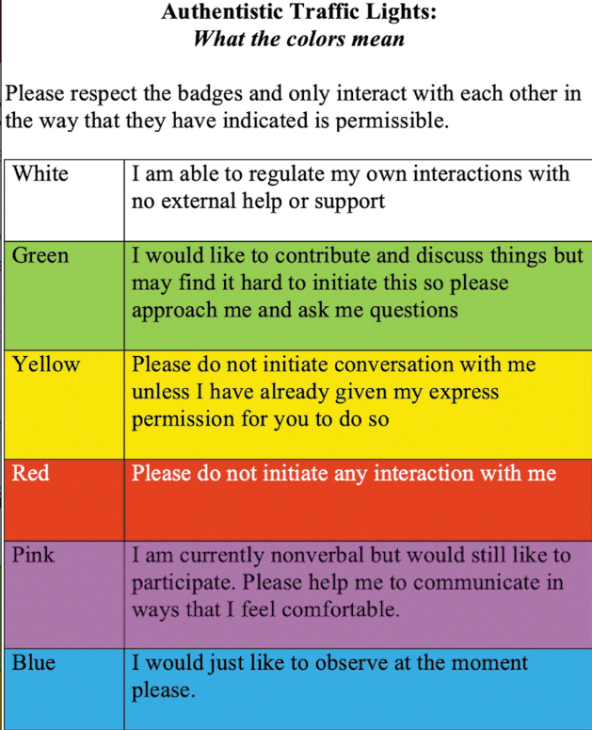
In preparation:
Notes:
Coproduction with Autistic Adults: Reflections from the Authentistic Research Collective | Autism in Adulthood (liebertpub.com)

Slide 2
AHPs Leadership & co-working with the voluntary sector to explore the development of autism-informed pathways
Vicky Romilly – SLT, Trainee Consultant in Learning Disability and Autism
Kathy McKay, Autistic Nottingham
Working with colleagues from Autistic Nottingham and IMROC
Notes:
Introductions
Today we will:
Discuss perspectives from a career spent in Learning Disabilty and Autism Services

Slide 3
Introductions – career & learning roadmap
Sharing to learn
Timeline of career development
– understanding perspective
Sharing co – working experience
Population Health and AHP Leadership
Notes:
Aim of today: to share and learn, not to present completed work
Ambitions for future
Lived experience
To explore key
1998 qualified – working in special schools, community clinics and Children’s Centres.
1999 – working across childrens and adult learning disability services
2000 sensory based training
2000-2010 – Service Level Agreement with autism provider
Completed a masters Ed in Autism (adults) University of Birmingham
2009-2010 Scoping autism diagnostic pathways
2009 – working in ‘locked rehabilitation services’ & community services
2013-2023 Low Secure Service – setting up SLT service
2012 Post Grad Sheffield Hallam Autism / Asperger Syndrome
2015-2019 Scoping SLT pathways – CJLD, Community Forensic, Low Secure Mental Health Pathways, CAMHS, Adult Mental Health
2016 Supporting LDA transformation through workforce strategy
2018 Appointed as Clinical Director IDD Services
2021 Appointed as regional clinical lead LDA, Provider Collaborative
2022 Appointed to multi professional trainee Consultant in Learning Disability and Autism Pathway
2023 involved in the RCSLT co produced Autism guidance

Slide 4
My career journey and autism pathways – Reflections
Can we anticipate communication and sensory differences – are these understood as a wider determinant of health or significant health behaviour ?
How do we match population need to workforce strategy – and influence change locally?
How do we articulate human rights within services?
Are the barriers to AHP expertise and leadership development understood and mitigated?
Perspective on the quality of support that is not informed by neurodiversity
What does it take to be the lone voice?
Dare to Lead Hub - Brené Brown (brenebrown.com)

Slide 5
Engaging in workforce strategy
Learning from partnerships
Learning from data to influence future planning
Engaging in population based planning in a ‘cohort based’ transformation programme.
What does it take to mobilise new roles – how do we create cognitively diverse teams?
Rebel Ideas: The Power of Diverse Thinking - Matthew Syed Consulting
Notes:
Partnerships – listening to a social care perspective
Recognise the churn in workforce where therapeutic relationships are central
Being curious and asking why and for what purpose

Slide 6
Scoping need to influence population need change
2015 Community Forensic, Liaison and Diversion and Low Secure MH wards
2016 CAMHS Secure Childrens Home
2017 AMH Pathways
Avail of fortunate coincidences
Balance patient story with local population need & evidence base
Consider broader partnerships
Find an ally
Have a clear project charter -
Influence continually, not only in a forum
Better Evaluation
Notes:
MSc in Translational Health Sciences | University of Oxford

Slide 7
Learning from lives and deaths of autistic people who have died by suicide
Believe the autistic person who tells you that they feel suicidal, - even if such information comes in a different or unexpected manner.
Establish rapport, “I’m listening, and I want to support you”.
Give time for the autistic person to process what you are asking. Processing speed can vary widely among autistic people, particularly when in crisis.
Keep your information simple – ensure through asking that the person has understood your message Check that the autistic person has interpreted and responded to your questions in the way you expect. Autistic people can interpret assessment tools differently than intended.
Use visual aids to support the person to express their emotion
Social support is associated with reduced risk of suicidal thoughts in this population. Those who report feeling that they do not belong in the world or are a burden to others are more likely than others to feel suicidal. Promote feelings of belonging, connectedness and self-worth, which could prevent suicidal thoughts and behaviours in autistic people
Develop options and a plan – jointly with the person. (see Sarah Cassidy, Mental Health in Autism My Safety Plan attached)
Notes:
Current transformation plan
Population health
Partnership working
Proposal regarding RA support team
Recognition of capacity within diagnostic teams
males under the age of 25 years
family history of abuse/domestic violence, history of mental health problems.
Common risk factors for suicidality found within the general population
diagnosed prior to referral into adult mental health services
identified as having pre-existing mental health needs
had family involvement in their lives.
Point of some transitions ( education, setting, services)
There was some risk assessment and care planning
There was some evidence of uncertainty about service suitability and care need at the point of referral. This included one case of a failed transition at 17 years, leading to delayed transfer into AMH and delay to care.
how autism impacts on the individual,
specific communication needs (how the person processes information related to their care), and
how the person understands and communicates their own distress
FINDINGS
All had some form of risk assessment
2 out of three had been prescribed medication at the time of death
Exploring the person’s understanding of their autism
All clients had a level of insight into their mental ill health and did make attempts to communicate their level of distress.
There were reports of difference of opinion between clinicians in the perception of risk posed.

Slide 8
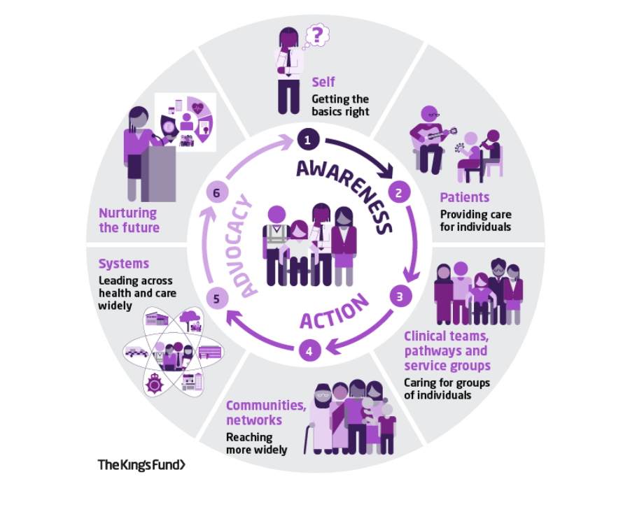
Understanding population planning
Communication and sensory as wider determinants of health
Health inequalities are described as ‘unfair and avoidable differences in health across populations and between different groups within society’ (The King's Fund 2020). Nationally, and internationally there is an evidence base that highlights the notion of avoidable deaths of autistic people who have died by suicide (INSAR 2021) and equally there is growing evidence of the impact of accessing mental health services – described a ‘lonely, difficult service experiences’ (Brede 2022).
“Do not occur randomly or by chance.” “You will know it” “wraparound people at the highest risk will change population level need sooner” Consider intervention over-time alongside this (Chris Bentley 2023)
Leadership for Population Health | The King's Fund (kingsfund.org.uk)
Notes:
Dougal, D. and Buck, D. (2021) My role in Tackling health inqualities . A framework for allied health professionals. The Kings Fund. Downloaded from: word template (kingsfund.org.uk) 3.7.23
International Society for Autism Research (2021) Autism Community Priorities for Suicide Prevention An International Society for Autism Research Policy Brief.

Slide 9
Recognising the evidence base
Research & evidence base
Evidence highlights that people’s communication needs, sensory needs and executive functioning impact on their ability to engage in physical healthcare services – and as such as highlighted as significant barriers to healthcare. (Mason et al 2019).
Brice et al (2021) explored autistic people’s view on the significance of and availability of adjustments to mental and physical healthcare and found three key areas through their surveys: the sensory environment, clinical and service context, and clinician knowledge and communication.
Adjustments across healthcare settings were widely rated as being important however, seen as rarely available. Significantly, participants reported that having access to a clinician who is willing to adapt their approach to suit the person’s preferences was significantly more important for participants attending mental health settings.
Notes:
Vicky
Research /evidence base
Brice S, Rodgers J, Ingham B, et al. The importance and availability of adjustments to improve access for autistic adults who need mental and physical healthcare: findings from UK surveys. BMJ Open 2021;11:e043336. doi:10.1136/ bmjopen-2020-043336
Mason, D., Ingham, B., Urbanowicz, A. et al. A Systematic Review of What Barriers and Facilitators Prevent and Enable Physical Healthcare Services Access for Autistic Adults. J Autism Dev Disord 49, 3387–3400 (2019). https://doi.org/10.1007/s10803-019-04049-2

Slide 10
The realities of pathways now
“Although professionals agree with the views of autistic people and professional guidelines regarding the need for a tailored approach to MHI for autistic adults, in practice they felt constrained by the limited availability of resources and the challenges of inflexible systems”. (Moore et al 2023) Mental Health Professionals’ Experiences of Adapting Mental Health Interventions for Autistic Adults: A Systematic Review and Thematic Synthesis | Journal of Autism and Developmental Disorders (springer.com)
Learning from experience of co produced guidance Autism – clinical information for SLTs | RCSLT
Utilising economics of healthcare to influence population based planning & therefore workforce redesign.
LSE Modelling Cost-Effectiveness in Healthcare Online Certificate Course | LSE Online
Notes:
LSE Modelling Cost-Effectiveness in Healthcare Online Certificate Course | LSE Online

Slide 12
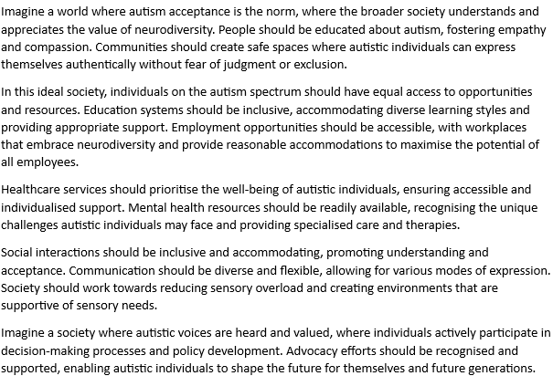
Letter to the Future & visioning the future
Kathy McKay as part of NHFT Transformation work not to be reproduced.

Slide 13
Reflections and learning together about partnerships
Galvanising interest in peer support roles
Listening to experience of people who have received services
Gaining learning through sensory friendly environments project
Not developing but growing new roles
Building sustainability & shared commitment

Slide 14
CO-WORKING
Exploring Synergies between NHS and Third-Party Sectors
Key Aspects of Collaboration
Challenges
Benefits
Experiences Shared
Shared Goals: Aligning efforts to enhance support for autistic individuals.
Mutual Interests: Focusing on improving services and well-being.
Joint Initiatives: Collaborative projects for the benefit of the community.
Communication: Addressing potential gaps between NHS and third-party sectors.
Coordination: Overcoming logistical challenges for effective collaboration.
Obstacles: Navigating complexities inherent in diverse organizational structures.
mproved Services: Enhancements in the quality of support and care.
Shared Resources: Maximizing resources through collaborative efforts.
Collective Impact: Achieving a more significant positive influence on the community.
Anecdotes: Stories illustrating successful collaborative efforts.
Testimonials: Quotes from individuals involved, showcasing the impact of the co-working environment.

Slide 15
PROJECT PROGRESS
Peer support
The Project
Shaping Autism-Friendly Mental Health Services through participants experiences
Challenges
One of the project's challenges involved the difficulty in engaging participants and securing their commitment.
Support
The role of an APSW (Autism Peer Support Worker) is instrumental in enhancing accessibility to services for individuals with autism.
Notes:
Challenges in engaging autistic individuals stemmed from factors such as mental health concerns and limited energy ("spoons"), despite providing reasonable adjustments, highlighting the importance of flexible approaches to accommodate varying needs.
Support
According to participants APSWs contribute by leveraging their understanding of welfare systems, aiding in appointment scheduling, advocating for individuals' needs, challenging misconceptions, and providing emotional support. They play a pivotal role in navigating healthcare, ensuring active listening during appointments, addressing medical gaslighting, and assisting with memory recall—all of which collectively contribute to a more accessible and supportive environment for individuals with autism.

Slide 16
Exploring the potential of peer support workers
Having someone who understands the persistent nature of autism is crucial. This support is essential, as it cannot simply be switched off or resolved." "Lived experience brings valuable knowledge, particularly in terms of coping mechanisms that are genuinely effective." J discusses the challenges of requesting reasonable adjustments and the minimal accommodations often offered. He highlights the need for someone to advocate for individuals and help them secure meaningful adjustments. According to J, peer support workers are critical in providing guidance, advocacy, and strategies to help individuals access and navigate support services effectively.

Slide 17
Exploring the potential of peer support workers
Autistic people advocated for a patient-led approach - involvement in decision-making and acknowledging individuals contributes to more effective mental health services”.
“The participants highlight the challenges that autistic individuals face when they are not treated with respect or understanding in healthcare settings. They express frustration with being stereotyped and emphasise the significance of recognising the "white coat effect," which can lead to heightened anxiety in front of healthcare professionals”.
This project undertaken locally highlights the importance of knowledge, respect, accommodation, and a human-centred approach to healthcare, ultimately advocating for a more inclusive and supportive healthcare environment and collectively highlights the importance of understanding and accommodating the needs of autistic individuals within healthcare services (Nicolaidis, 2015; Bradshaw, 2019; Morris, 2019; Lai, 2020).

Slide 18
PROJECT PROGRESS
Sensory friendly enviroment
We are actively conducting interviews with inpatients as part of our data gathering process.
We will analyses the data afterwards.
Currently
We encountered an unforeseen challenge during this period due to staffing availability which unfortunately led to delays in our usual operations and timelines.
Challenges
The sensory-friendly inpatient project aims to enhance the well-being of individuals & raise awareness of sensory thinking in the workforce.
The project
Notes:
The sensory-friendly inpatient project aims to enhance the well-being of individuals, particularly those with autism, by adapting the hospital environment, communication methods, and care plans to be more accommodating to sensory sensitivities.

Slide 19
DATA INSIGHTS
Autistic Peer Support Worker Project
Need for Autism Training
Barriers in Healthcare Access
Role of Accommodations
Human-Centred Approach
Importance of Supportive Facilitators
Notes:
Need for Autism Training: The data reveals a consistent theme indicating the importance of providing autism training, not only for healthcare professionals but also for individuals working in various sectors such as education and public services. Participants express a desire for a foundational understanding of autism to enhance interactions and support for autistic individuals.
Barriers in Healthcare Access: The insights highlight significant barriers faced by autistic individuals in accessing healthcare services. Issues such as the necessity for longer appointment times, challenges in the waiting area, and communication difficulties during appointments emerge as recurring concerns. This suggests a need for systemic changes and accommodations to improve healthcare accessibility.
Role of Accommodations: The data underscores the positive impact of accommodations, as seen in the discussion around the "Sunflower Lanyard program." Participants view subtle cues and accommodations as essential in facilitating more inclusive healthcare services for autistic individuals. This insight suggests that small, thoughtful adjustments can significantly improve the overall healthcare experience.
Human-Centred Approach: The data emphasizes the significance of a human-centred approach in healthcare settings. Autistic individuals express frustration when not treated with respect or understanding, advocating for a more dignified and individualized approach to care. This insight calls for a shift in healthcare practices towards greater empathy and consideration for the unique needs of each individual.
Importance of Supportive Facilitators: The insights highlight the positive impact of having facilitators or group leaders with an understanding of autism. Participants express increased confidence and openness in discussions when supported by individuals who comprehend and have experience with autism. This suggests the value of having knowledgeable and empathetic leaders in peer support programs.
These data insights provide a foundation for understanding the challenges faced by autistic individuals and point towards potential areas of improvement in support services, training programs, and healthcare practices.

Slide 20
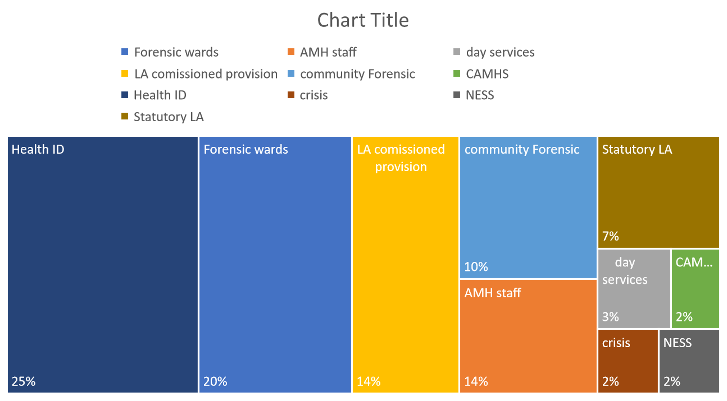
Supporting a learning culture
SPELL trainers within Nottinghamshire
Ensuring training is co delivered with experts by experience
Understanding our baseline of capabilities
Building a collective of trainers through the NATP
Developing skills as a Leadership coach

Slide 21
Future ambitions – pathways based on population health
How do we demonstrate the value of social based thinking approaches at an earlier stage?
Socialthinking - Social Thinking
NHSE Meeting the Needs of Autistic Adults in Mental Health Services
The four levels are:
Level 1: Staying well in the community
Level 2: Planned mental health care
Level 3: Crisis care
Level 4: Inpatient care
Notes:
NHS England » Meeting the needs of autistic adults in mental health services

Slide 22
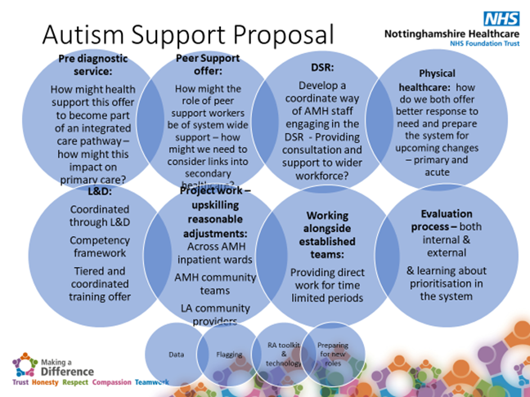
Future ambitions – Planning for Wellbeing influencing Mental Health Investment
Notes:
National Autism Trainer Programme (NATP) | Anna Freud

Slide 23
Future ambitions – engaging in Realist Evaluation
Notes:
Realist Reviews and Realist Evaluation | Oxford University Department for Continuing Education
“How, why, and for whom do speech and language therapy and occupational therapy support impact (or not) on autistic adults accessing mental health pathways.”
If a reasonable adjustment toolkit that is developed and piloted with the local autistic community is implemented with training for health care practitioners into local care pathways (C) then autistic people whether patients or employees are more likely to feel listened to; understood and engaged with (O) because health care providers have a better understanding, experience and built confidence in how to adapt consultation/interactions to meet needs (M)

Slide 24
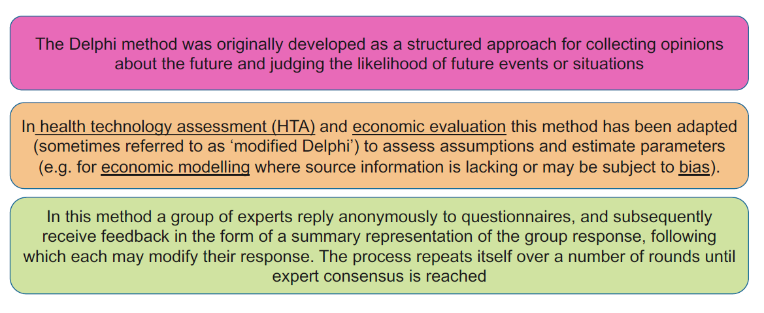
Future ambitions – understanding the potential of Delphi

Slide 25
Future Ambitions – how might the observatory engage with BRACE?

Slide 26
Thank you for listening – happy to discuss !
Notes:
Commitment 3 Make development packages available for non-medical consultants recognised by the Centre for Advancing Practice | Health Education England (hee.nhs.uk)

