Slide 1
Some personal reflections on the practical implementation of Coproduction in Bradford District Care NHS Foundation Trust
Lorna Dunsire
AHP Lead for Community Mental Health Services for Adults

Slide 2

What is the key to effective
Co-production?
Some personal reflections on the challenges and benefits of aspiring for Coproduction, in a Care Trust which serves a diverse and large geographical area
“For the NHS…be a leader for the health of a population, not just the healthcare” Sir Michael Marmot, 2021

Slide 3
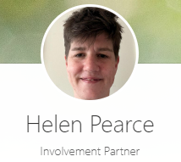
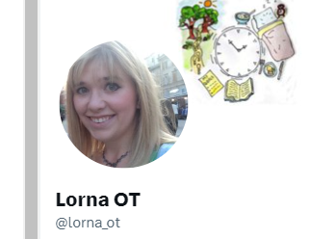
Introductions
(Pronouns: she/her)

Slide 4
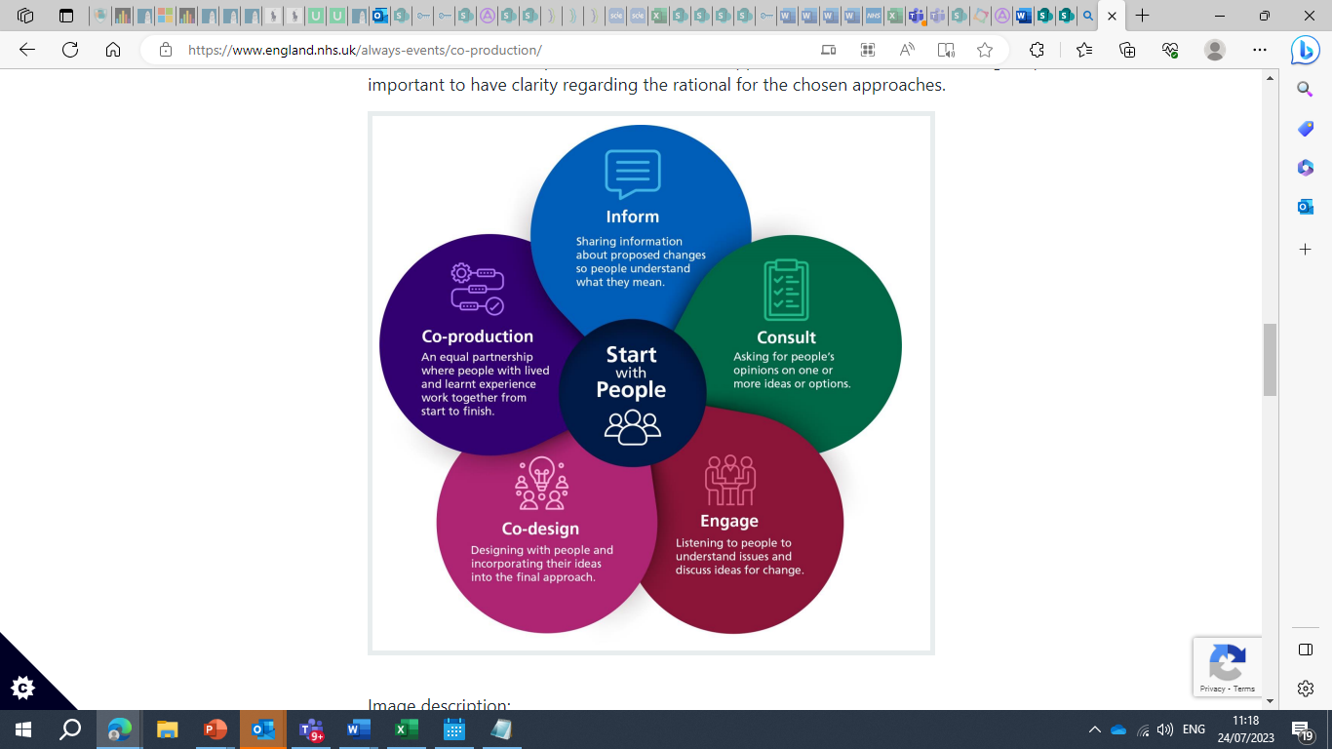
ACTIVITY and Challenge:
Please share comments in the chat function
Q. Why is involvement and coproduction important?

Slide 5
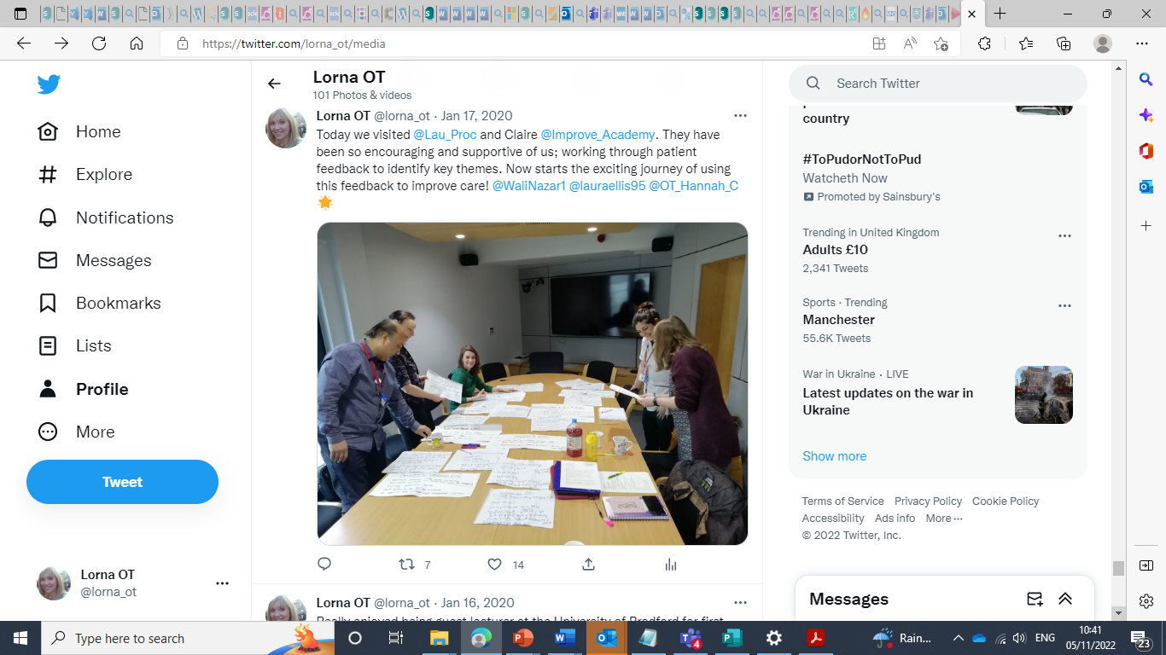
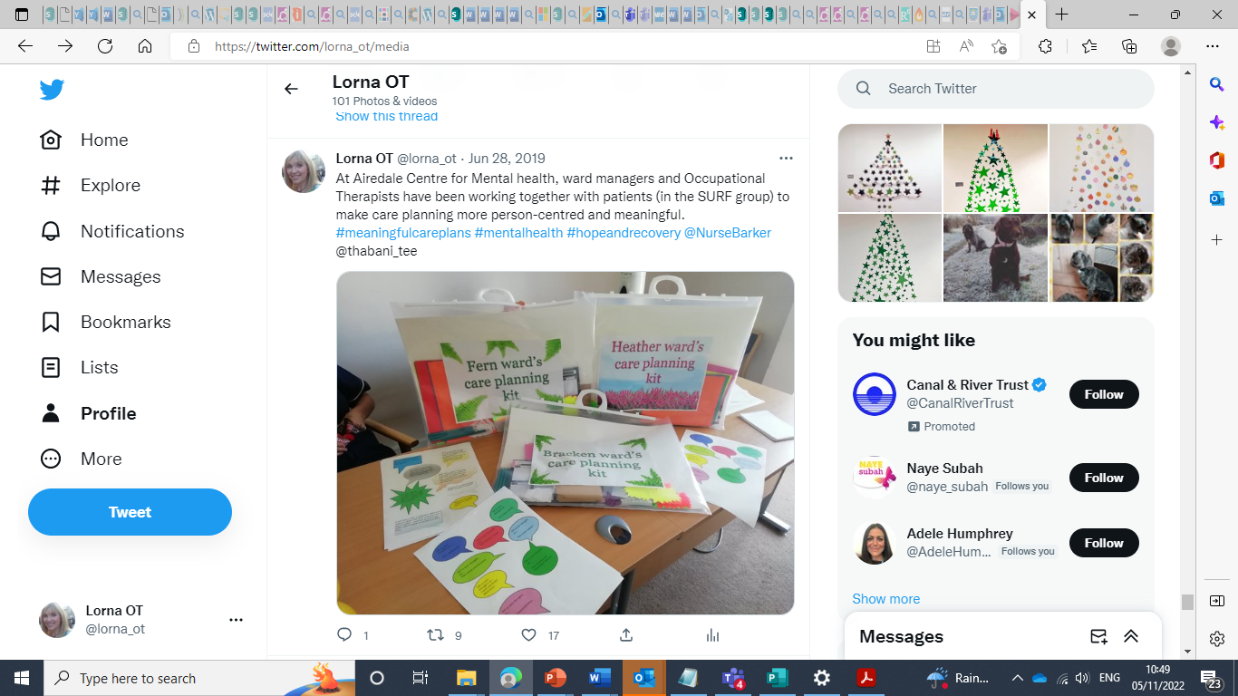
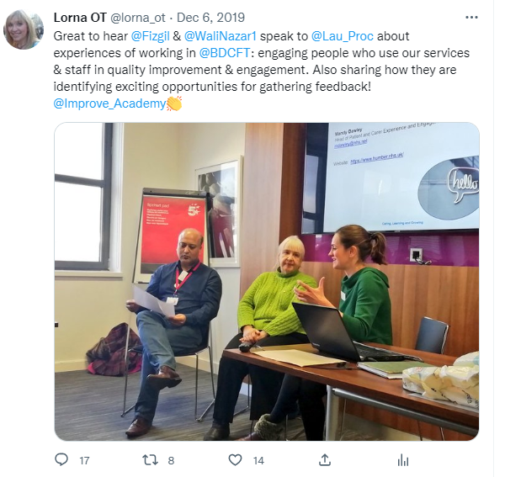
The power of involvement – for services
Improving experience
Improving outcomes
Resource management
Improved employee experience
Relevance of services
Meeting the needs of populations
Learning and feedback
Safety and risk

Slide 6
‘A relationship where professionals and citizens share power to plan and deliver support together, recognising that both partners have vital contributions to make in order to improve quality of life for people and communities’.
(Slay and Stephens, 2013, p.3)
The value of Coproduction
‘putting people first’
Enabling effective cultural change
Keeping the person at the centre of care delivery
(Boyle et al., 2010; Lwembe et al., 2017; Willis et al., 2018).

Slide 7
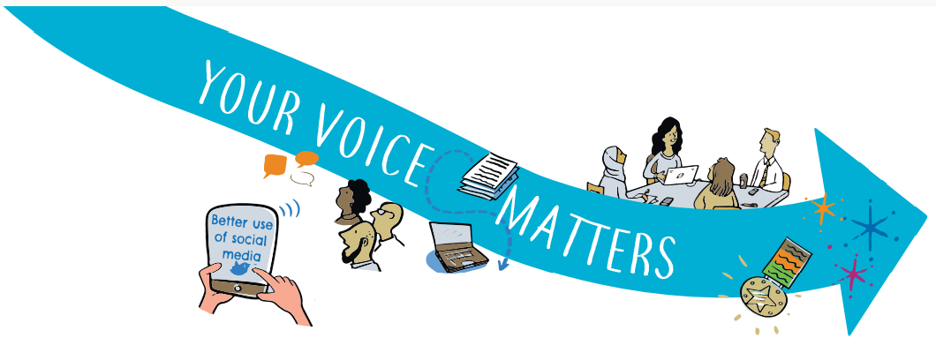
The role of Involvement Partners in BDCFT
It is important that we recognise the value that Involvement partners bring to our trust and the contribution they make to the culture in the organisation, as well as coproduction

Slide 8

Experience of being an Involvement Partner
Helen: What does being an Involvement Partner mean to you?
Why is involvement important?

Slide 9

What challenges and barriers have we encountered?
‘SURF’ group (Service User Rights Forum)

Slide 10
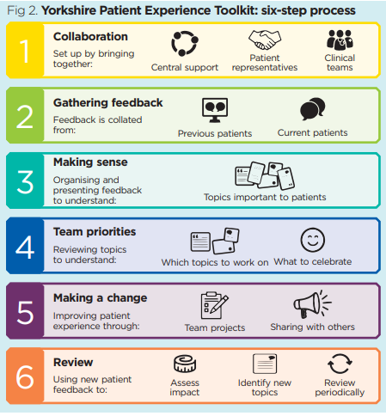
The Patient Experience Toolkit
An example of a tool which uses feedback and understanding experience to drive improvements.
201216-Testing-a-toolkit-that-uses-patient-experience-feedback-to-improve-care.pdf (improvementacademy.org)

Slide 11
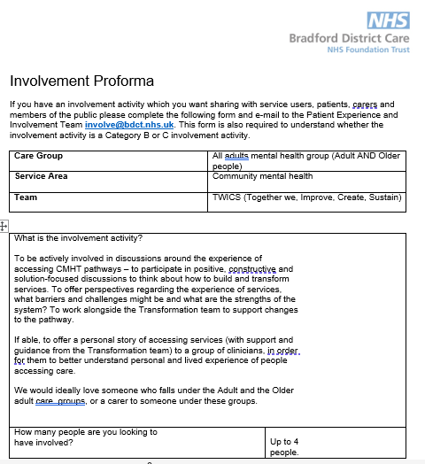
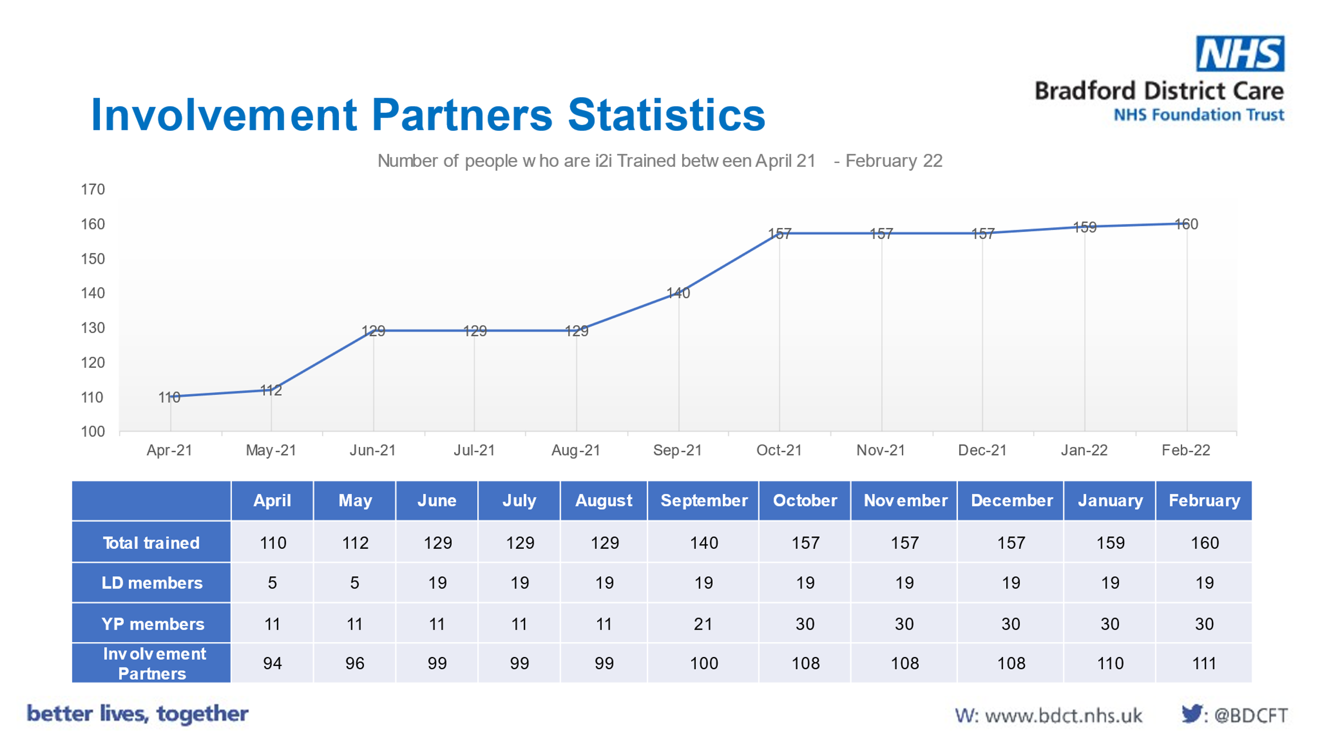
Community mental health Transformation and Coproduction
Challenges for Coproduction in our service:
No universal responsibility for coproduction
‘Involvement Team’ informally seen as responsible for coproduction
Lack of understanding: the meaning of coproduction, Practical applications, or shared language
Impact on individuals – needs constant reflection
Notes:
Involvement partners approached to say they were not aware of the opportunities

Slide 12
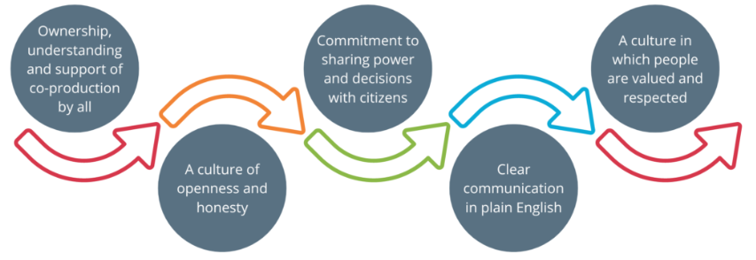
Focus on Values and Behaviours
Image from A Co-production Model. Produced by NHS England and Coalition for Personalised Care. (NHS England, 2022, accessed online, available from: NHS England » Co-production)

Slide 13
This diagram is from Annex A: Implementation of the Statutory guidance for working in partnership with people and communities.
It shows some of the different ways of working with people and communities.
(NHS England, 2022)

Slide 14


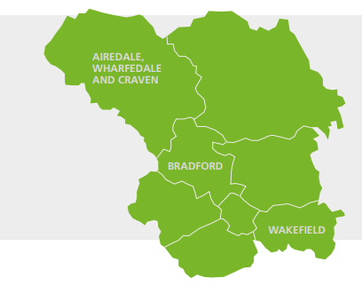
Bradford and Craven
Meeting the needs of the population: targeted approaches
Diverse population and community
Wealth of VCS partners
Existing structures in the trust – the Involvement Team and Involvement Partners

Slide 15
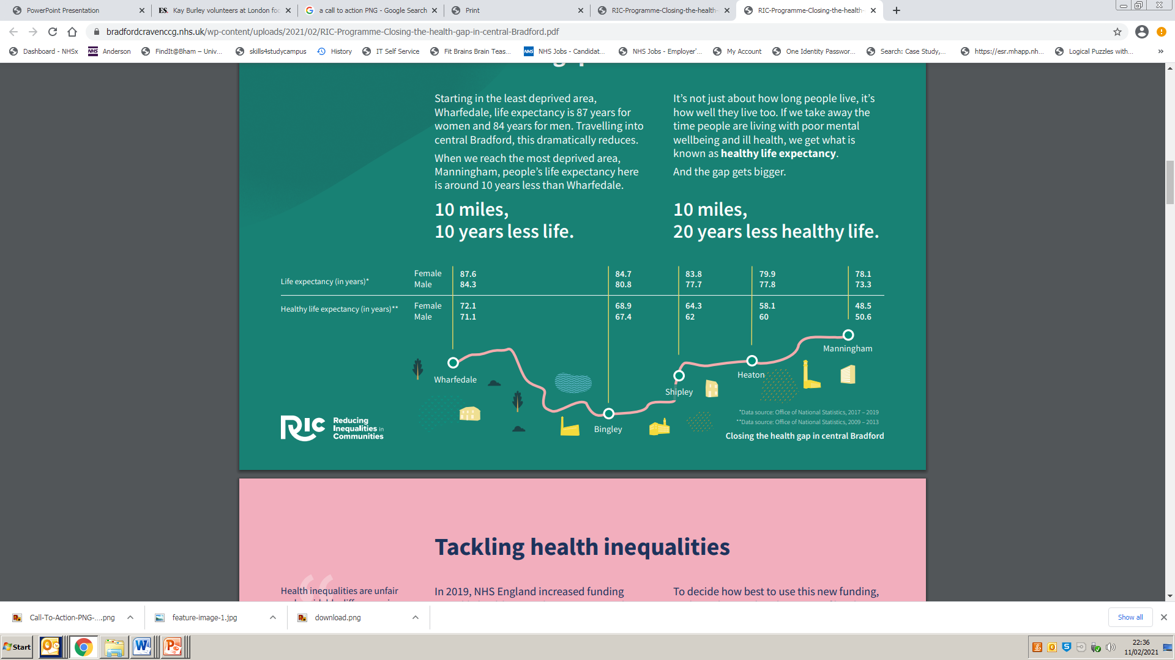
Health inequalities in the Bradford District
Knowing where challenges lie, and identifying under-served populations
For Craven we also need to consider the inequalities linked to rural locations , social isolation and an ageing population

Slide 16

Hearing, listening to, and involving the Voice of Experience
Practical tips – Questions to ask yourself:
How can I best hear the Voice of Experience? (method)
Am I asking the right questions?
Who can help me?
Which/where/who are the under-served populations?

Slide 17
Community Open-access involvement (‘Outreach’)
Support to External organisations across place and partnerships to facilitate Involvement activities
Open-access involvement (‘In-reach’)
Wider community are able to attend public meetings and events (Internal)
Voice of Experience
Foundation of involvement in care
Advisory activities
Involvement partner activities
Advocacy / decision making activities
Complex involvement partner activities
How to hear the Voice of Experience –
The Bradford Model
Employed
Involvement roles
‘Ambassador’

Slide 18
MSc exploration of Coproduction:
Research questions & objectives
Literature review – Key themes:
Culture
Different perspectives and defined groups (the provider; professionals; lay actors; and the community)
Sharing power
Practical resources - The ladder of coproduction (The National coproduction advisory group and Think Local, Act Personal, 2021) coproduction is on a scale: Coercion; Educating; Informing; Consultation; Engagement; Codesign; and finally, Coproduction.
Research Question 1:
How effective are Bradford District Care NHS Foundation Trust’s current practices and structures, in delivering co-production in community mental health services?
Research Question 2:
What, if any, are the relevant organisational interventions required to promote better coproduction in BDCFT’s Community Mental Health Services?
Notes:
Intended organisational impact:
Anticipated Benefits:
To evaluate the effectiveness of coproduction within Community Mental Health Services.
To provide recommendations and an action plan for improving the overall quality of coproduction.

Slide 19
Key emergent themes from all respondents
Power Dynamics
Common theme for IP’s and Clinical staff (but not PCEIT)
Decision-making
Management control
Influence
Agency
“Tokenistic approach from staff, feels like they know best so they’ll decide”
“different sections of the Trust have their own standards - some are great, some are tokenistic”
“Improving the quality of care we give to our service users. Services that better suit individual needs”.
“Person centred approach to delivery the right support/intervention at the right time”
“When staff choose when to involve people – they are holding the power”
“Power differentials. People feeling threatened by other people's views. People believing their training means they are the experts”
Approach
Authenticity vs. Tokenistic
Intent
Commitment
Prioritisation
Quality
Perceptions of:
Relationships
Value
Voice
Awareness
Accurate appraisal
Accessibility
Themes established through deductive and inductive analysis
Knowledge
Coproduction
Roles
Language
Systems
“Lack of awareness [from clinical staff] that it is an option to get people involved and how to get people involved”.
Support Mechanisms
Systems and processes
Guidance documents
Policies and procedures
Supervision and support
“[Coproduction] means nothing to me” (staff)
“I don’t know what [coproduction] is” (staff)
“A wish for someone else to come up with the answer: ‘you are the experts, you must know what you're doing’”
Roles and Responsibilities
Clarity
Planning
Communication
“Coproduction is seen as an ‘add on’ - people are too busy and just don't have time to commit or think”

Slide 20

GROUP TASK
(Breakout rooms- 15 minutes)
What do you currently do to promote Involvement and Coproduction?
What could you possibly do to improve this?

Slide 21
The following 7 slides are from the Ladder of Coproduction by Think Local, Act Personal
This resource can be accessed here: Ladder-of-coproduction.pdf (thinklocalactpersonal.org.uk)

Slide 22
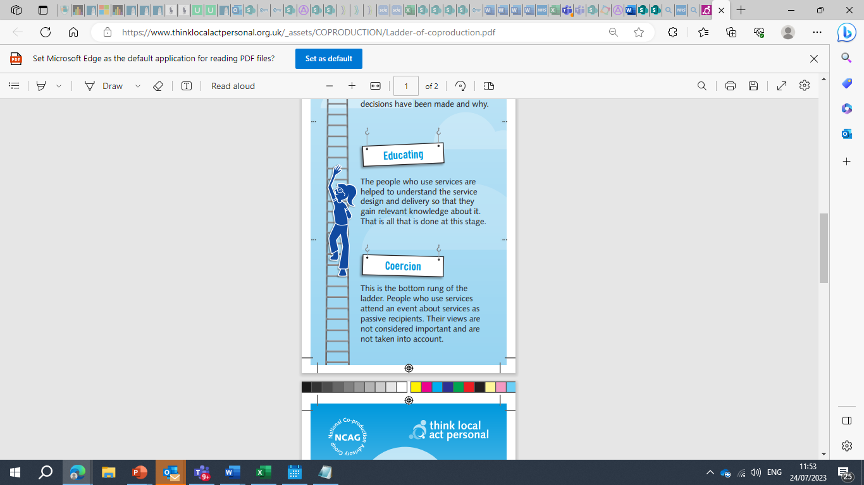

Slide 24
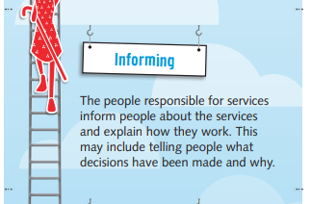

Slide 25
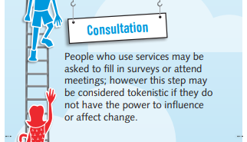

Slide 26
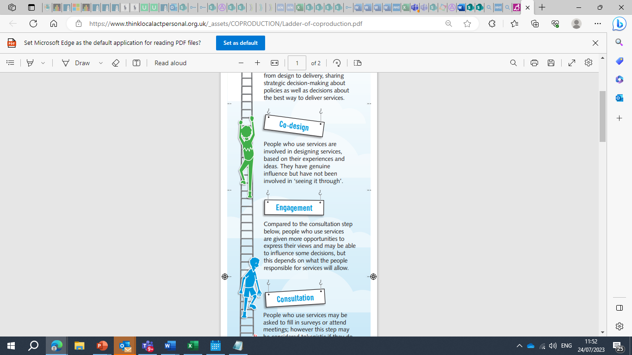

Slide 28
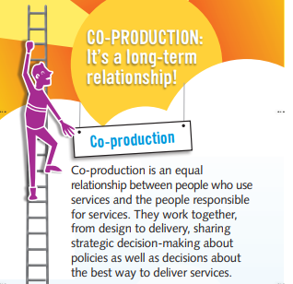

Slide 29
ACTIVITY: Please share comments in the chat box
How would you rate the current levels of coproduction in your service?
Coercion
Educating
Informing
Consultation
Engagement
Co-design
Coproduction

Slide 30
Rating the quality of coproduction in BDCFT – an interesting mismatch

Slide 31
External Environment
External Factors often create the need for change (e.g. CMH Transformation).
External Factors
- National Drivers for
Coproduction, ICB
- Bradford People’s Board
Application of the Burke-Litwin organisational change model (1992)
Transformational factors
Key to success of change. Organisational objectives are captured at this level. Often change plans start here.
Leadership
Senior management buy-in
Promoting values
Strategy
- High level strategic
Objectives
- Your Voice Matters
Organisational Culture
Recognised value of CP—stories
Care Trust Way
Transactional factors
Management Practices
- Promoting CP
- Role modelling by managers
Structure
- Responsibilities for CP
- Reporting activities & accountability
Systems (Policy and procedure)
- Standard operating procedures
Change focus
Work Unit Climate
- Power sharing
- Attitudes and teamworking
Individual factors
Key to enabling individual performance.
Individual skills & tasks
- PCEIT—experts in CP
- Clinical teams recruit
Individual needs and values
- Supervision
- Support
Motivation
- Promoting experience and knowledge
- Sustainable
OUTPUTS
Evidence of effective change
Impacts on performance and outcomes
Ind. & Org. Performance
- Effective involvement
- Coproduced services

Slide 32
Summary of Key Findings
There was a clear misalignment in:
Culture
Mechanisms
Roles and Responsibilities
Relationships
Knowledge and skills
Power sharing
Systems (Standard Operating Procedures, guidance at service level)
Methods of communication
Methods of feedback
Protection and support for involvement partners

Slide 33
AREAS OF FOCUS
For relational work to build better communications and interactions with Involvement Partners and emphasise their value to the Trust.
To build better channels of communication, infrastructure and connection between clinical teams and The Involvement team.
To implement use of individual narratives to develop a shared vision and create effective feedback loops (to reduce misalignments in perception).
To establish clarity regarding roles and responsibilities for coproduction, including refreshing policies and procedures from this angle.
To support and develop the Involvement team through knowledge and skills acquisition.
To design and develop key processes and forms for the Involvement team, to guide, advise on and support coproduction in service settings and support implementation of the Your Voice Matters Involvement Strategy.
To establish rewards and support and supervision structures, to monitor performance including outcomes and recognise coproduction in practice.

Slide 34
Patient and Carer Experience and Involvement Change proposal
2022/23
Effective Experience – Your Voice Matters
November
December
January
February / March
Commence Appreciative Inquiry (PCEIT, IP’s, Staff)
Identify areas of strength and growth plan
- Clarify pathways with volunteers and peer support
Ensure appropriate roles and designate power sharing
Clinical settings profiles
Shared narratives
Celebrate involvement
Defining involvement activity
Systemwide training offer
Plan mobilised and measured Inc. case studies published
-Double loop Feedback mechanisms through IPs
Design Agreed
Increased engagement across demographics
Wide-scale clinical teams engagement – Roles and Responsibilities
Leadership throughout
Vision
Robust comms
Review branding – Team activity
Identify engagement opportunities/channels
-Training plans Implemented
Develop leadership case study
Review current engagement / Audience = Gap Analysis
Review and Identify resources for engagement – current Involvement champions for all areas (MH, LD, PC etc).
-Training plans built
Comms review
- Regular reviews
-Streamline pathway to reduce waste
Build rewards structure
Reaffirm priorities (Team SWOT)
Strategy
(Accessibility, targeted approach)
Recruit role specific IP’s
Gather comms specific feedback and host IP ideas generation session
Develop guidance for effective Coproduction
Current state Mapped
Clarity on complaints and escalations
Current Comms process review – LEAN methodologies
- Individual plans actioned
- IP Personal development plan review
-Engagement with IP’s, clinicians, VCS, District wide
Agree principles for role modelling
Link with formal leadership champions
-
Systems and processes
Identify comms strategy
Initial notification of transformation
Key areas of interest – action plans
Current Position
Leadership
Team development
Communications

Slide 35
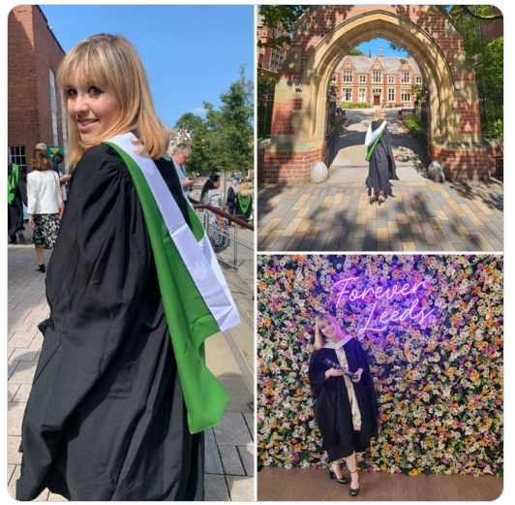
I have been asked to speak about the opportunities I have been lucky to access as an AHP:
Opportunities to be creative and time to deliver activities outside of my ‘set’ role, such as Service User Involvement Groups
Roles as Project Manager in Community mental health Transformation, and Involvement Transformation Lead
Apprenticeship-
MSc in Senior Leadership – University of Leeds Business school

Slide 36
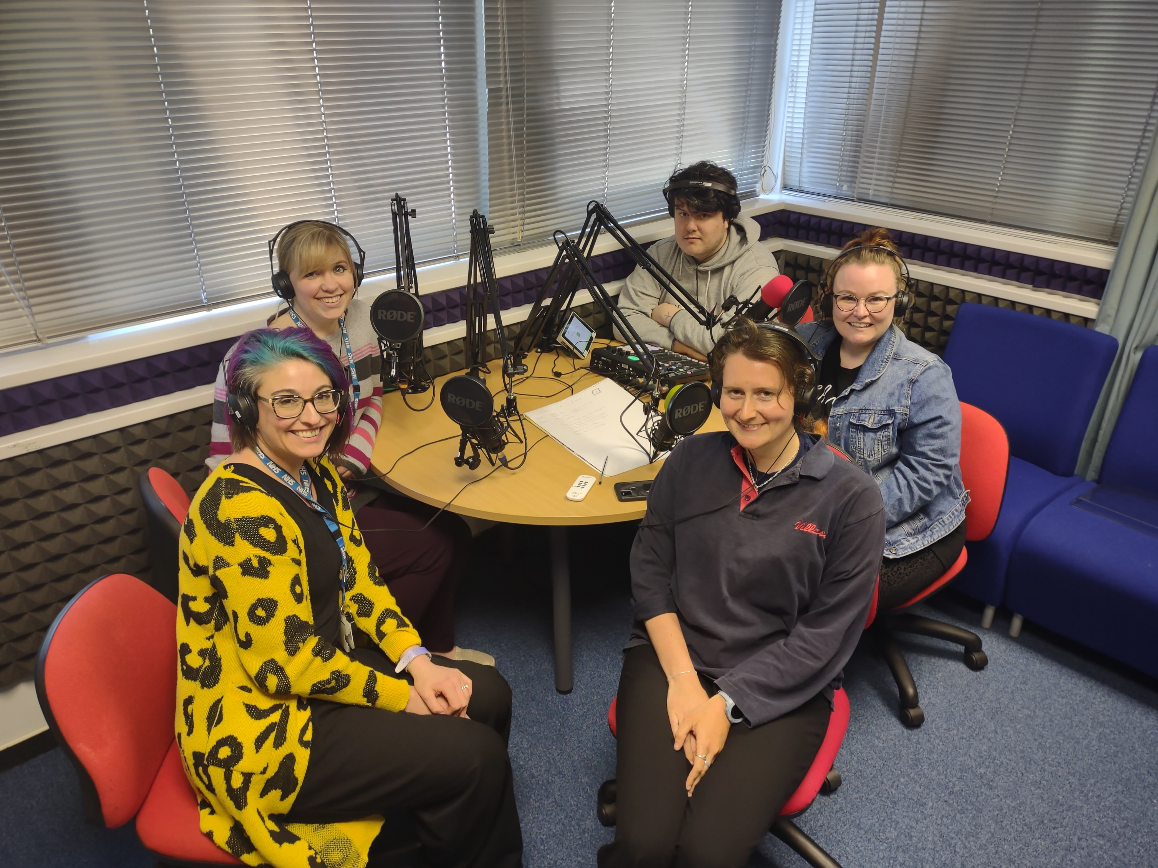
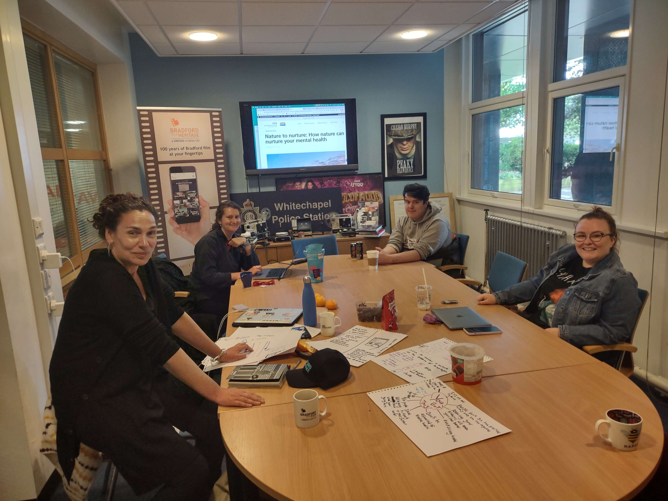
Digital Initiative

Slide 37

A long journey and a significant culture change!
Applying AHP skills to influence wider agendas
New role as Senior Patient Experience Manager
addressing the ‘mismatch’ in perceptions
establish commitment to power-sharing and feedback.
Understanding how to reach under-served populations – always learning!

Slide 38
“Meaningful engagement and listening to people’s experiences can result in better-quality care… Listening to people properly, harnessing the lessons from feedback and implementing them to make changes is not always straightforward.
How can the NHS and social care services ensure that they really listen to and learn from people and communities?”
(The King’s Fund, 2022. Accessed online at: Improving quality of care | The King's Fund (kingsfund.org.uk))

Slide 39
ACTIVITY and Challenge:
Please share comments in the chat function
What do AHPs have to offer to the coproduction agenda?
What commitment will you make to supporting involvement and coproduction?

Slide 40
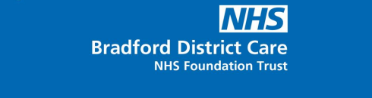

Involvement and coproduction is everybody’s business.
Thank you.

